Slide 1
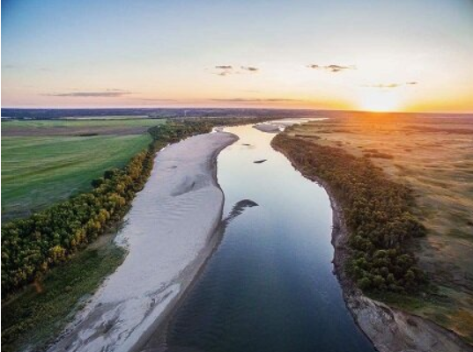
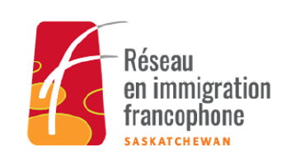

Study on the Interactions between Francophone Newcomers and Indigenous Communities in Saskatchewan: Results, Context and Next Steps
Thursday, September 17, 2026
North Battlefield, Saskatchewan

Slide 2
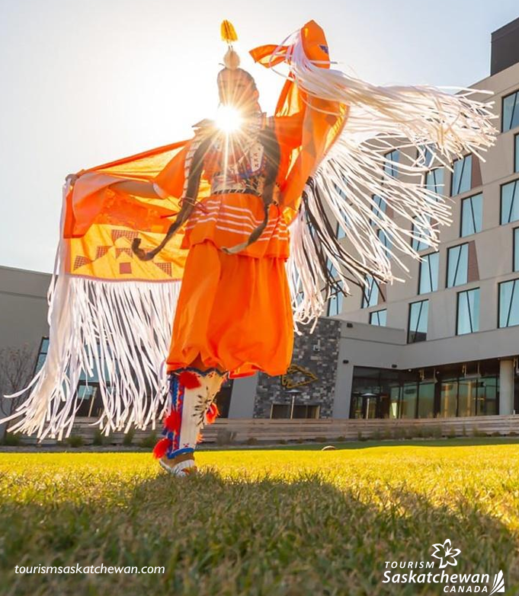
Contents
Introduction
1. Structuring trends in interviews
2. Cross-cutting issues identified in the focus groups
3. Operational Recommendations
4. Proposed activities

Slide 3
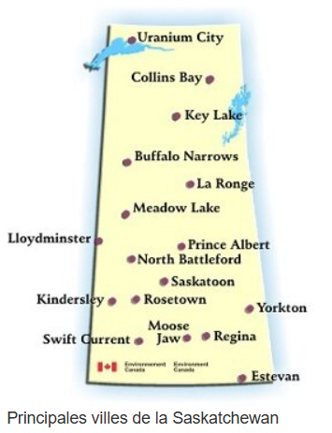
OBJECTIVES of the study
Identify existing dynamics between Francophone newcomers and Indigenous communities
Highlight key barriers to interactions
Identify the factors that promote intercultural rapprochement
Identify common trends from diverse experiences
Formulate concrete recommendations and priority actions to support intercultural initiatives adapted to the local context
Source: www.rif-sk.ca

Slide 4


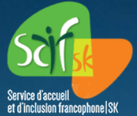

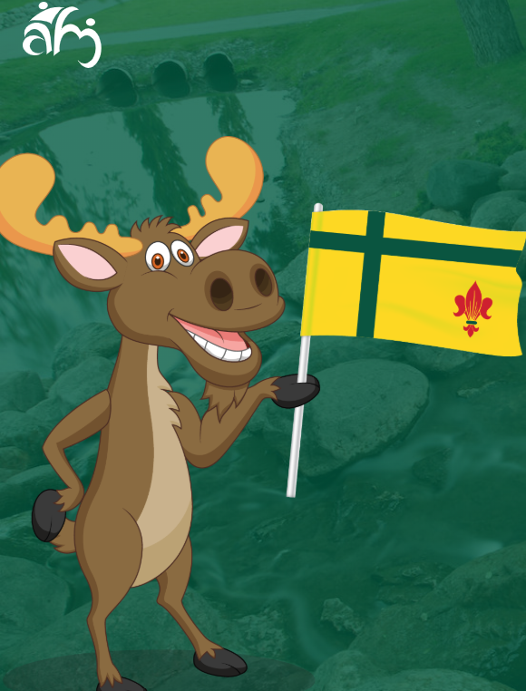

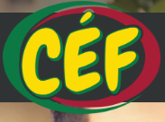

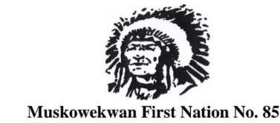



Introduction: METHODOLOGY
Qualitative approach based on multiple perspectives
20 semi-structured key informant interviews
  Community organizations
  Educational Institutions
  Indigenous Actors
  2 focus groups
  Regina
  Saskatoon
Data collection between January and March 2026
Analysis to identify cross-sectional trends (not representative of all perceptions)
Consideration of the diversity of perspectives within and between communities

Slide 5
1. Structuring trends in interviews
  Current nature of the relationship
  2. Mutual perceptions
Limited but growing relationships
Interactions, especially in formal contexts:
  Schools, workplaces, organizations, events
Relationships that are often functional rather than social
Few spontaneous interactions between individuals
Young people more inclined to intercultural rapprochement
High potential when meeting spaces are created
Newcomers' perceptions often influenced by:
  Stereotypes and partial information
Positive development with better understanding:
  Colonization, residential schools, trauma
Development of empathy and solidarity
More diverse and contextual Indigenous perceptions
Certain tensions linked to structural dynamics (inequality, marginalisation)
Quote 1 – Initial Lack of Knowledge and Changing Perceptions
«Many newcomers arrive with preconceived notions about Indigenous peoples, often based on what they see on the street or what they are told. But when they learn about the history of residential schools and colonialism, there is often a moment of awareness. Some are even starting to make connections with their own history.» »

Slide 6
1. Structuring trends in interviews
3. Level of mutual knowledge
4. Interaction Experiences
Low mutual knowledge between communities
Newcomers: Limited knowledge of Indigenous history
Settlement priorities (employment, language, housing)
Indigenous communities: limited knowledge of migration realities
Key role of schools and educational institutions
Positive experiences related to:
  Cultural activities (pow wow, festivals)
  Educational and artistic events
  Dialogue Circles
Importance of a security framework and appropriate facilitation
Few direct conflicts observed
Tensions linked mainly to misunderstandings and prejudices
Quote 2 – The potential for rapprochement
"When people take the time to share their stories and experiences, you discover that there are a lot more commonalities than differences."

Slide 7
1. Structuring trends in interviews
5. Identified barriers
6. Factors that promote positive interactions
Lack of structured opportunities to meet
Presence of prejudices and stereotypes
Language barriers
Geographical distance between communities
Institutional and political constraints
Mainly structural and systemic barriers
Influence of colonial heritage and institutional dynamics
Immersive cultural activities
Collaborative art projects
Structured Community Dialogues
Youth Initiatives
Involvement of Elders and Knowledge Holders
Importance of Safe Spaces
Strong impact of first-hand experiences and sharing of stories
Quote 3 – The Still Limited Nature of Relationships
"Interactions exist, but they remain mostly in institutional contexts: schools, community organizations, sometimes work. Personal relations between the two communities are still quite rare. »

Slide 8
1. Structuring trends in interviews
7. Role of the various agencies
8. General summary
Need for a multi-stakeholder collaborative approach
Role of the RIF-SK: coordination and facilitation
Role of Indigenous organizations: legitimacy and cultural anchoring
Role of Public Institutions: Financing and Barrier Reduction
Role of schools: key long-term lever
Shared and collective responsibility
Importance of structured partnerships
Absence of major open conflicts
Main issues:
  Lack of mutual knowledge
  Few meeting spaces
  Historical structural dynamics
High potential for rapprochement
Perceptions evolve with interactions
Key to reconciliation:
  Dialogue
  Joint activities
  Acknowledging historical realities
The main challenge: structuring interactions in the long term
Quote 4 – The heart of the problem
"The main obstacle is not a conflict between the communities, but the fact that they have almost no opportunities to meet and really get to know each other."

Slide 9
2. CROSS-CUTTING ISSUES IDENTIFIED IN THE FOCUS GROUPS
Analysis of Key Findings from the Regina Focus Group
Relations between communities
Existing but limited, one-off and indirect relationships
Mainly mediated by institutions
Few structuring projects or lasting partnerships
Interaction spaces
Francophone schools
Cultural and community events
Reconciliation initiatives
➡️ Interactions mainly social/cultural, few economic or professional
Major obstacles
Mutual ignorance (history, realities, cultures)
Cultural differences (e.g., spiritual dimension, role of elders)
Risk of stereotypes and social distancing
Key role of intermediaries
Francophone organizations
Educational Institutions
Cultural organizations
➡️ Essentials to facilitate contacts
Courses of action
Awareness and intercultural sharing
Considering cultural differences
Youth and Parent Engagement
Development of activities to build trust

Slide 10
2. CROSS-CUTTING ISSUES IDENTIFIED IN THE FOCUS GROUPS
Analysis of Key Findings from the Saskatoon Focus Group
Lack of opportunities to meet
Rare and one-off interactions
Lack of structured spaces for dialogue and collaboration
Information deficit
Information focused on:
  Francophone community
  Language integration
Little content on Indigenous peoples
➡️ Risk of misperceptions
Influence of stereotypes
Informal deterrent messages (e.g. neighborhoods)
➡️ Create social distance, bias and hinder interactions
Culture as a key lever
Joint cultural events
Valuing traditions
Identification of commonalities
➡️ Building trust gradually
Priority groups
Young people (more open to interaction)
Importance of Involving Parents
Courses of action
Structured intercultural activities (e.g. cross-stays)
Raising awareness among families in advance
Mobilizing public funding
Solid logistical support

Slide 11
2. CROSS-CUTTING ISSUES IDENTIFIED IN THE FOCUS GROUPS
Conclusions
Differences in Discussions
Regina :
Discussion more focused on the current structure of interactions
Importance of taking cultural differences into account
Saskatoon :
More critical and reflective discussion
Focus on:
Lack of information for immigrants
The role of stereotypes
The need to create more meeting spaces
Points of convergence
The two groups converge on several observations:
Interactions between communities exist but remain limited.
Contacts are mainly mediated by institutions.
There is a significant lack of mutual knowledge.
There are not enough opportunities to meet.
Current initiatives are loose and often ad hoc.
Quote 5 – The need for relationships built over time
«You can't just create an event and think that the relationship will build automatically. Trust takes time. Indigenous communities must be involved in the design of initiatives from the outset. »

Slide 12
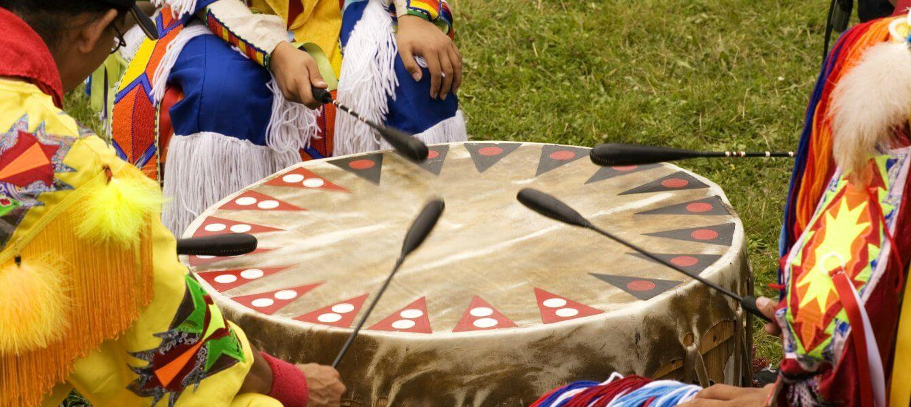
3. OPERATIONAL RECOMMENDATIONS
  1. Structuring an annual provincial program for intercultural rapprochement
Objective: To move from one-off initiatives to a planned and sustainable approach.
Modalities: The RIF-SK could coordinate an annual program that includes :
Organized participation in pow wows and Indigenous cultural events;
Immersive tours (e.g. Batoche, reserves, Indigenous museums);
Structured dialogue circles;
Joint cultural activities (music, dance, food).
The key condition is to focus on small groups and interactive activities rather than purely symbolic events.
Perceptions evolve with experience.
Aborder les cultures autochtones à l’Université • Néo UQTR

Slide 13
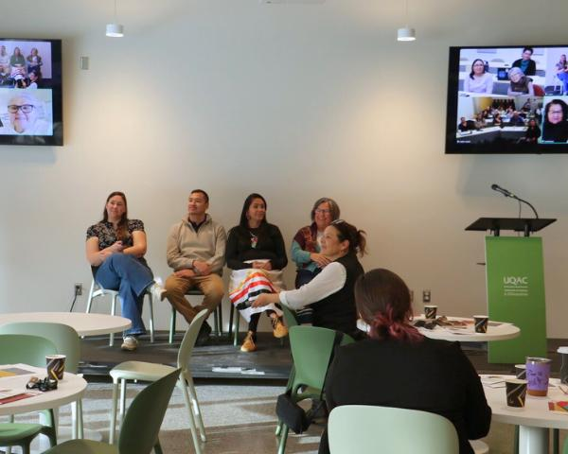
3. OPERATIONAL RECOMMENDATIONS
  2. Systematically integrate a module on Indigenous realities into the reception pathways
Objective: Reducing the knowledge gap in the first few months.
Terms: Francophone settlement organizations could:
Integrate a mandatory module on:
    The History of Indigenous Peoples,
    Residential schools,
    Contemporary issues;
Organize an immersive activity in the first 6 to 12 months;
Prepare participants before cultural meetings (protocols, historical context).
Early exposure is key to preventing stereotypes.
Atelier de transfert du projet de mobilisation des savoirs, des réalités et des perspectives des Premiers Peuples dans la formation en éducation, psychoéducation et travail social | Université du Québec

Slide 14
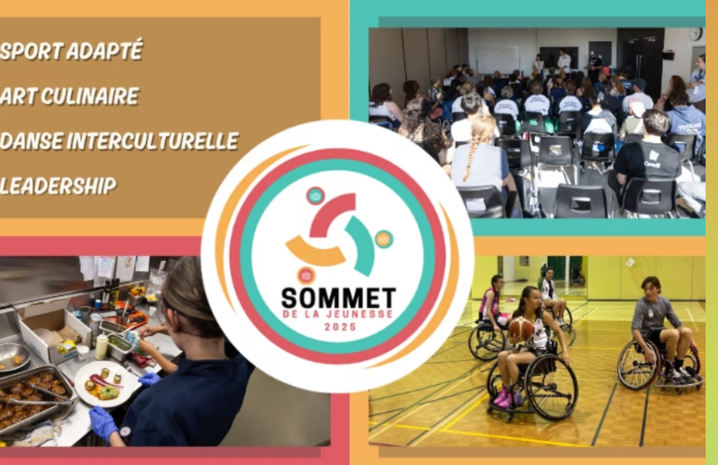
3. OPERATIONAL RECOMMENDATIONS
  3. Prioritizing youth and school initiatives
Objective: Focusing on intergenerational leverage.
Terms: Schools and youth organizations could:
Develop joint projects between Indigenous youth and newcomers;
Promote immersive activities (workshops, leadership, sports, arts);
Integrate parents into certain initiatives;
To value the commonalities related to colonial experiences and cultural diversity.
Youth is identified as the most open and transformable group.
Association Jeunesse Fransaskoise | Activités en français pour jeunes en Saskatchewan

Slide 15
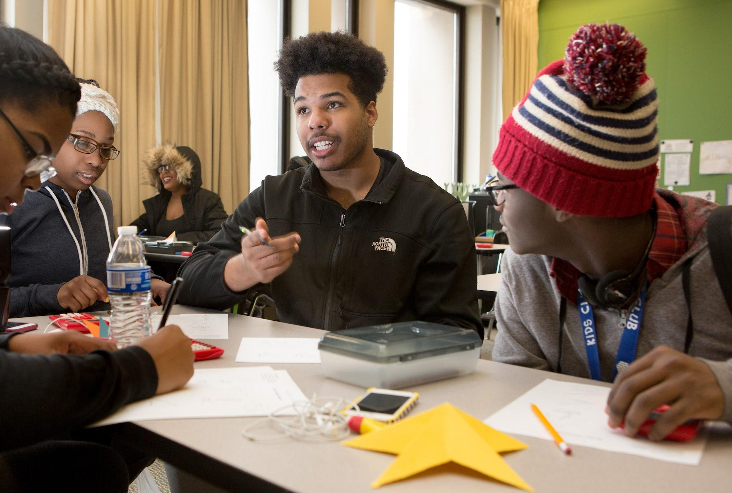
3. OPERATIONAL RECOMMENDATIONS
  4. Create a standing round table for the RIF-Indigenous organizations
Objective : Structuring the long-term dialogue.
Terms: The RIF-SK could:
Establish a formal round table with Indigenous representatives;
To ensure a balanced representation (institutional and community);
Define an annual joint action plan;
Periodically assess progress.
This would avoid one-off partnerships that are dependent on individuals.
Voices of Black youth remind adults in schools to listen — and act to empower them | Ontario Institute for Studies in Education

Slide 16
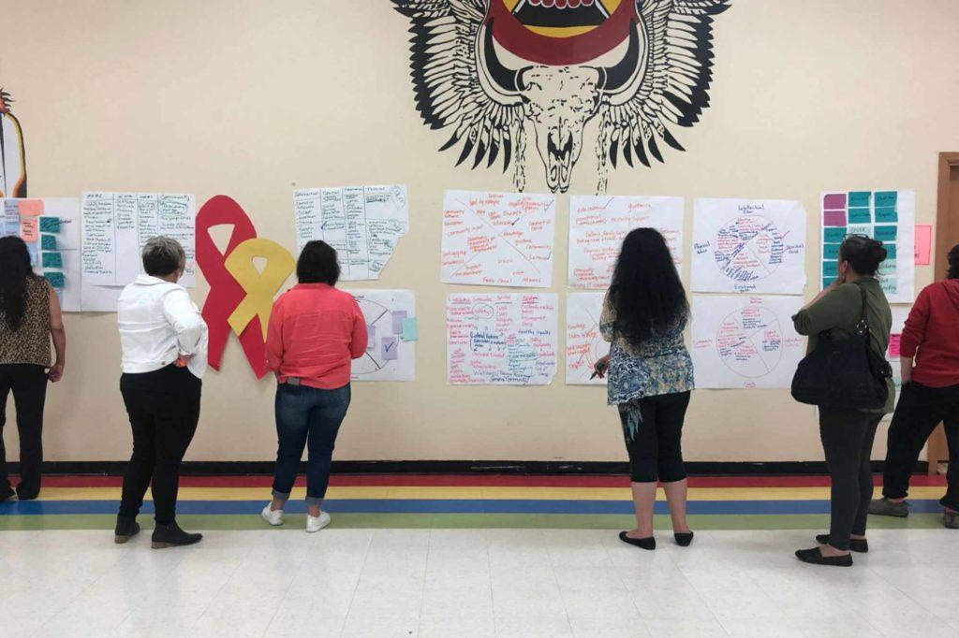
3. OPERATIONAL RECOMMENDATIONS
  5. Financially and logistically support joint initiatives
Objective : Reduce identified systemic barriers.
Terms: In collaboration with public institutions, it is recommended that:
Create a fund dedicated to merger projects;
Financing transportation to reserves or events;
Support formalized partnerships;
Supporting under-resourced regional organizations.
Several obstacles are logistical and budgetary rather than relational.
Funding | Aboriginal Friendship Centres of Saskatchewan

Slide 17
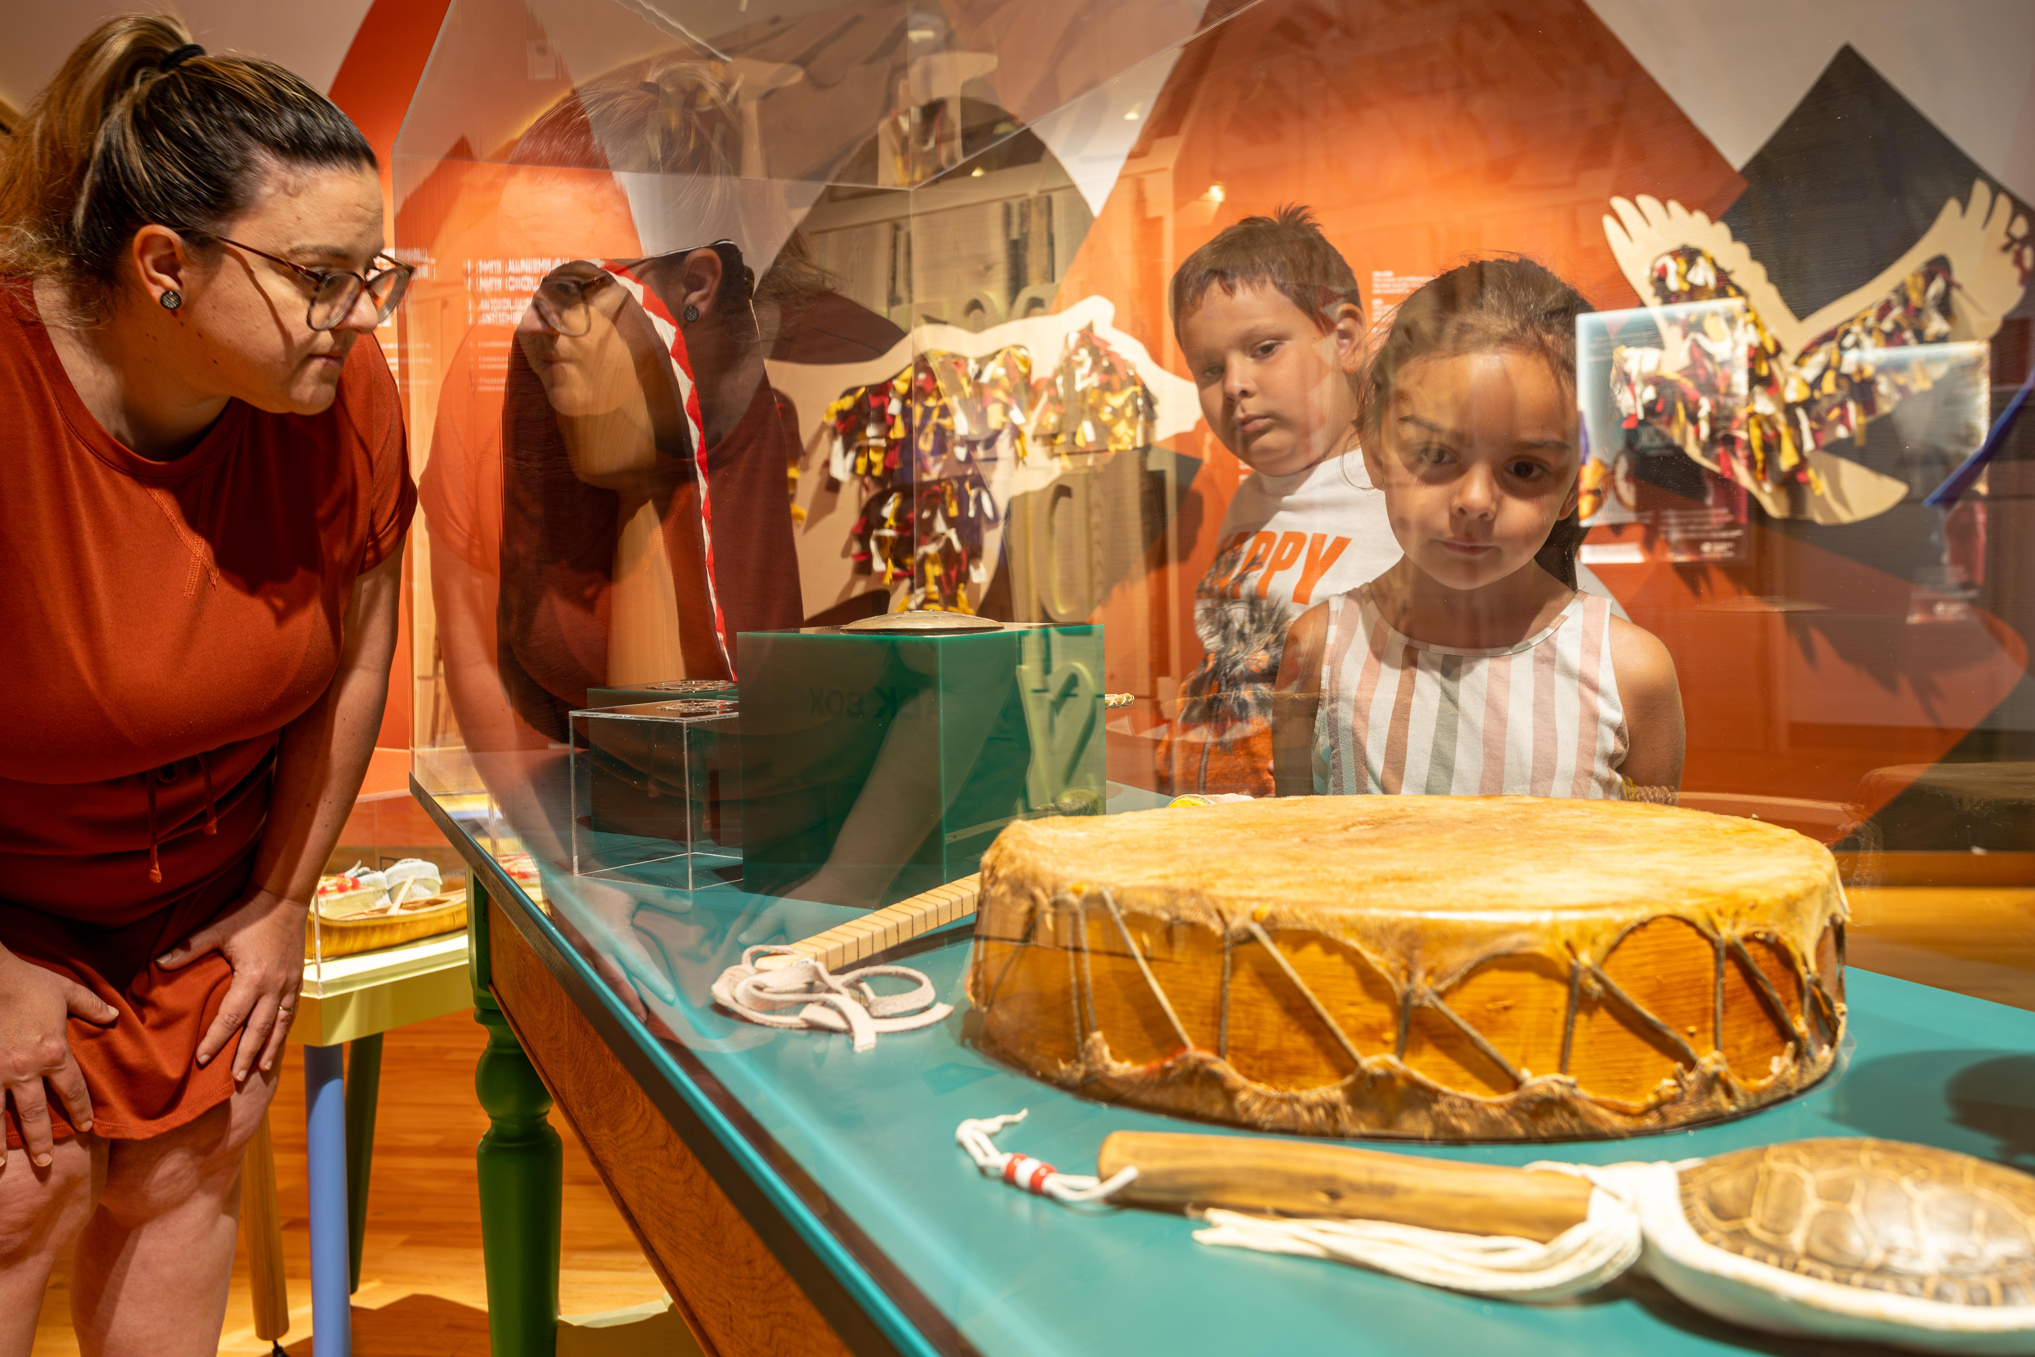
3. OPERATIONAL RECOMMENDATIONS
  6. Develop a communication and ongoing outreach strategy
Objective : Fighting structural biases.
Terms: The RIF-SK, in collaboration with its members, could:
Highlight positive stories of interaction;
Disseminate information capsules on Indigenous realities;
Promote joint successes;
Raising awareness of urban poverty issues to deconstruct stereotypes.
The negative perceptions observed are mainly related to lack of knowledge and partial exposure to certain social realities.
Tourisme Autochtone Québec - Les musées autochtones : lieux de patrimoine vivant

Slide 18
4. PROPOSED ACTIVITIES
  Intercultural Dialogue Circles
Description : Organization of 4 dialogue circles per year bringing together:
Francophone newcomers
Members of Indigenous communities
Cultural Facilitators or Elders
  4. Collaborative cultural and artistic workshops
Description : Workshops bringing together Indigenous artists and newcomers around:
Music
Visual Arts
Kitchen
Tales and traditions.
  2. Organized participation in Indigenous cultural events
Description : Organization of delegations of participating Francophone newcomers:
Pow wow
Métis Festivals (Batoche)
Local Indigenous Cultural Events.
  5. Immersive educational tours
Description : Organization of educational visits for French-speaking newcomers:
Batoche National Historic Site
Indigenous Museums
Local Indigenous communities.
  3. Youth Intercultural Camp (Summer)
Description : 3-day camp with:
Indigenous Youth
Youth from Francophone immigrant families.

Slide 19

Thank you for your attention!
institutcompass.org

